Slide 1
Chamber Stain Flow Results

Slide 2
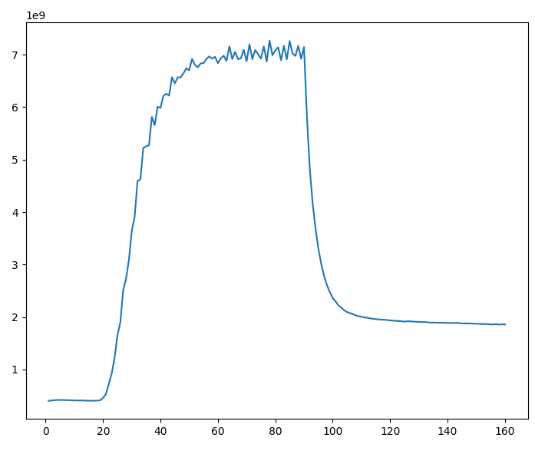
Full flow chamber results
Flow antibody mixture from multiplexer into chamber by only flowing that solution and nothing else
[C]50 time = 30.3s
[C]75 time = 35.4s
[C]90 time= 42.8s
[C]100 time = 57.0s
Peak = 7E9
Plane out =1.85E9

Slide 3
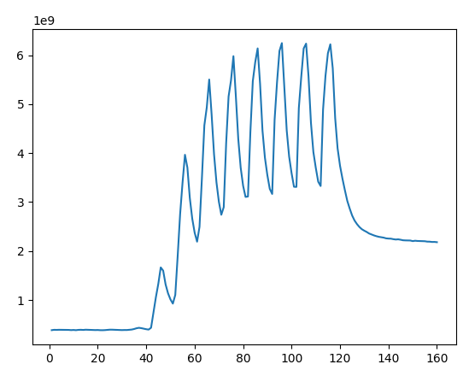
Staggered Flow
Flow antibody solution for 5 seconds and stop to settle for 5 seconds
[C]50 time = 53.0s
[C]75 time = 61.2s
[C]90 time= 72.7s
Peak = 6.25E9
Plane out =2.19E9
[C]50 flow time = 28s
[C]75 flow time = 31.2s
[C]90 flow time= 37.2s
Peak = 6.25E9
Plane out =2.19E9

Slide 4
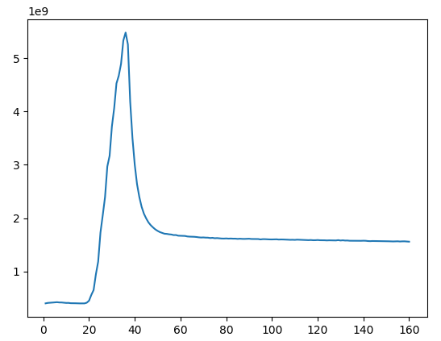
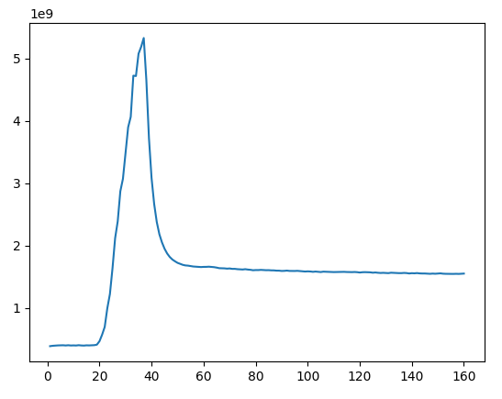
Bracketed Flow
Time A647 flow: 25
Time PBS flow: 11.25
Peak int: 5.5E9
Planed out int: 1.55E9
Time A647 flow: 27.25
Time PBS flow: 9.5
Peak int:5.32E9
Plane out int: 1.54E9
Total Flow time: 36.25s
275uL
300uL

Slide 5
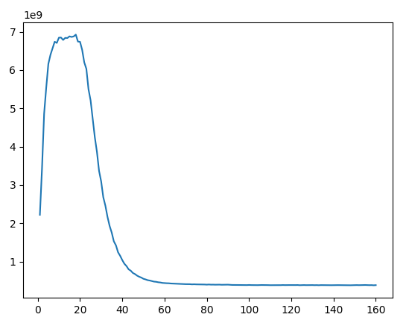
Flush Out Time
‘Dark Noise’ + offset = 3.75E8
Plateau region = 4E8
Difference = 6%
Difference is a few pieces of fluorescent junk
65s is best flushout time

Slide 6
Discussion
Stagger was not enough between pulses to plane out so interpretation is hard
Plane out for full flow =1.85E9
With bracketed flow, plane out = 1.55E9
Bracketed flow total flow time = 36.5s which is around [C]80 in full flow time
1.56E9 is 80% int for full flow which is super close to bracketed flow results
No difference in plateau for 300uL or 275uL bracketed flow
Bracket is not positioned correctly, can be tweaked to maximize better. Promising though

Slide 7
Future Thoughts + Experiments
Need to hone in better fluid flow dynamics
6s anticipated transition zone + 70uL chamber = 19s pulse is ideal
Run full flow packet through stain packet of various sizes. Sizes: 10, 13, 16, 19, 22, 25s
Trips of full flow for better calibration

